Slide 1
Disecting Neural Networks
Dr.Shailesh S

Slide 2
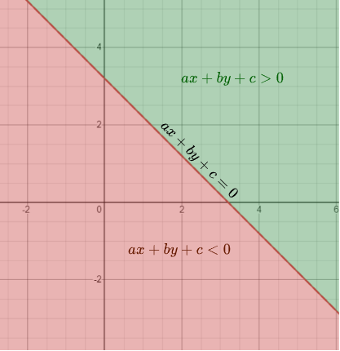
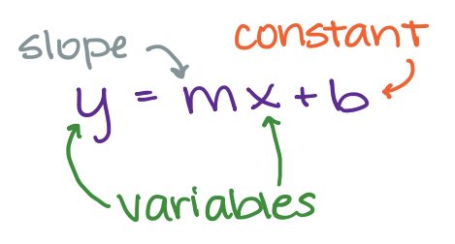
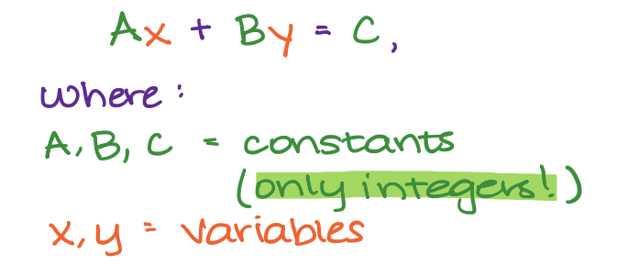
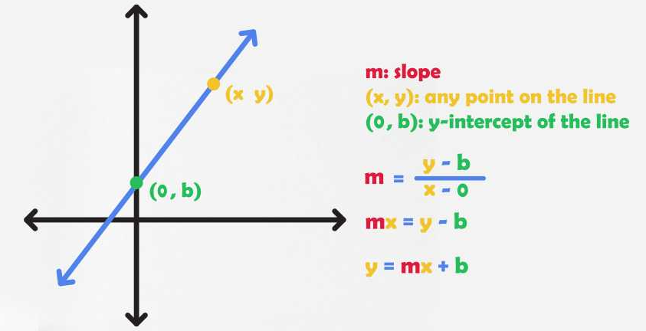
Equation of a LIne

Slide 3
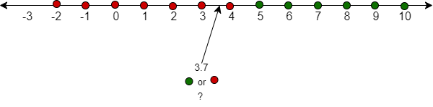

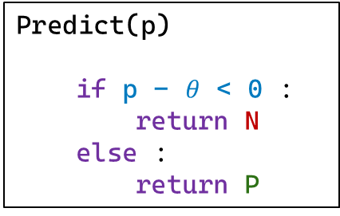
Classification : ReVISIT
Dataset
x | y
-2 | N
6 | P
7 | P
3 | N
2 | N
-1 | N
0 | N
5 | P
10 | P
4 | N
9 | P
8 | P
$θ$ = 4.5
Decision Boundry
Predict(p)
if p - $θ$ < 0 :
return N
else :
return P
Binary Classification

Slide 4
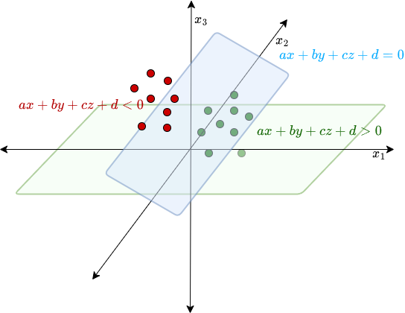
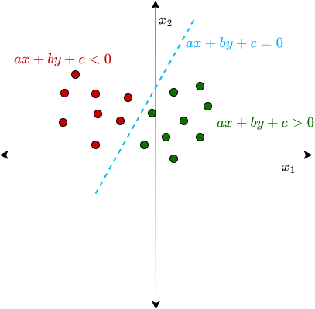
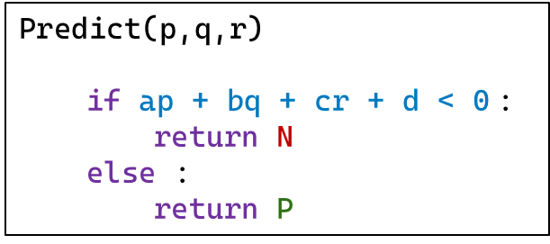
Classification : ReVISIT
2D - data
3D - data
Predict(p,q)
if ap + bq + c < 0:
return N
else :
return P
Predict(p,q,r)
if ap + bq + cr + d < 0 :
return N
else :
return P

Slide 5
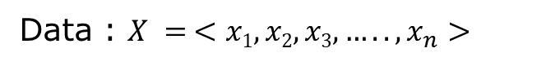
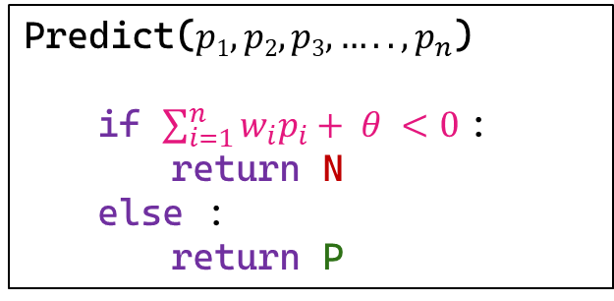
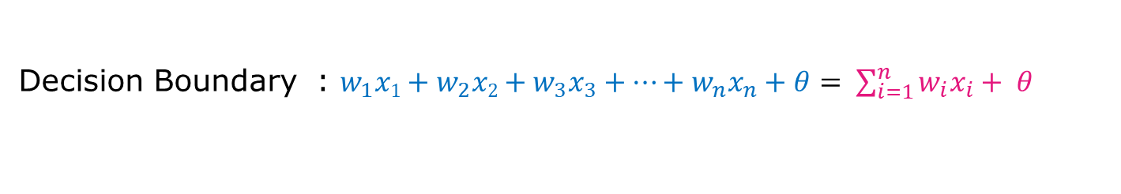
Classification : ReVISIT
Generalizing to n-dimensional space
Data : $X = <x1, x2, x3,….., x_{n}>$
Decision Boundary : $w_{1}x1+w_{2}x2+w_{3}x_{3}+…+w_{n}x_{n}+θ= \sum_{i=1}^{n}{w_{i}x_{i}+ θ }$
Predict($p1, p2, p3,….., p_{n}$)
if $\sum_{i=1}^{n}{w_{i}p_{i}+ θ }<0$:
return N
else :
return P

Slide 6
Perceptron
First neural network learning model in the 1960’s
Simple and limited (single layer models)
Basic concepts are similar for multi-layer models so this is a good learning tool
Still used in many current applications (modems, etc.)

Slide 7
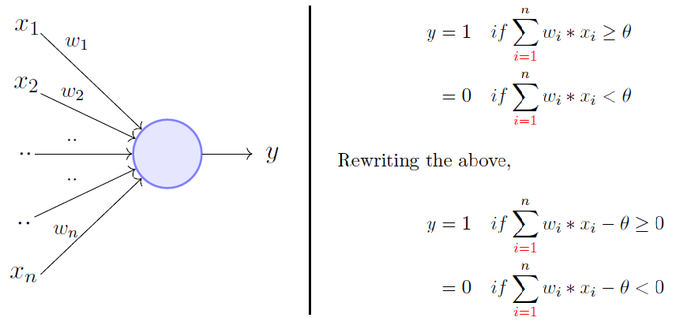
Perceptron Model

Slide 8
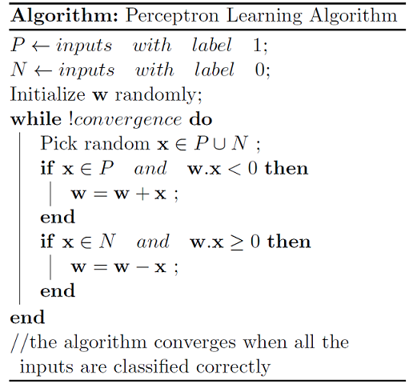
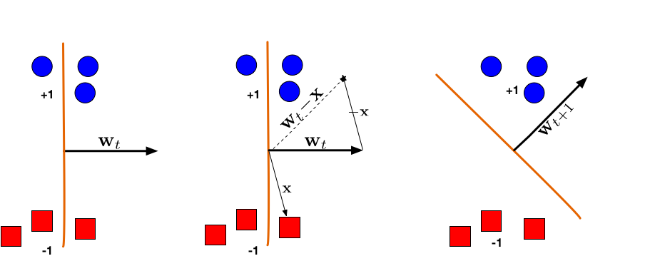
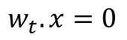
Perceptron Algorithm
$$w_{t}.x=0$$

Slide 9
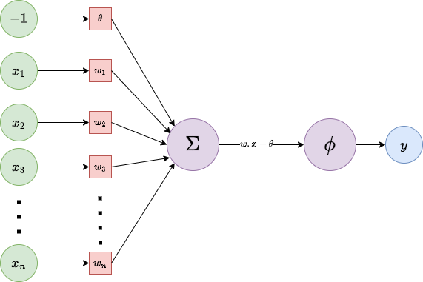
Perceptron Model

Slide 10
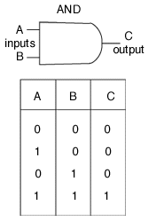
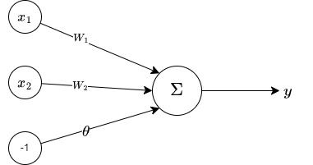
Learning AND gate

Slide 11
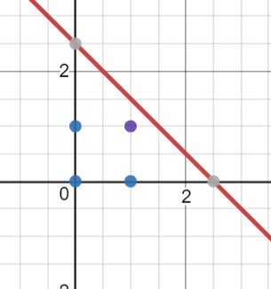
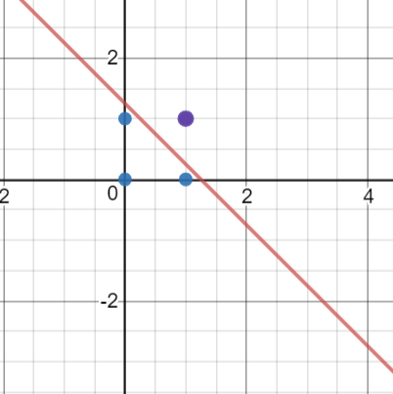
Learning AND gate
z = w₁.x₁ + w₂.x₂ – θ
w₁=1, w₂=1, θ= 2.5
1 x₁ + 1 x₂ – 2.5 = 0
w₁ | w₂ | -θ | (x₁,x₂) | z
1 | 1 | -2.5 | (0,1) - | 1x0 + 1x1 - 2.5 = -1.5
1 | 1 | -2.5 | (1,1) + | 1x1 + 1x1 - 2.5 = -0.5
2 | 2 | -2.5 | (0,0) - | 2x0 + 2x1 - 2.5 = -2.5
2 | 2 | -2.5 | (1,0) - | 2x1 + 2x0 - 2.5 = -0.5
2 | 2
2 x₁ + 2 x₂ – 2.5 = 0

Slide 12
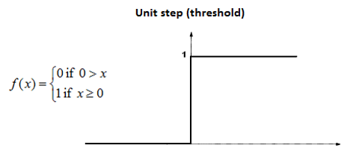
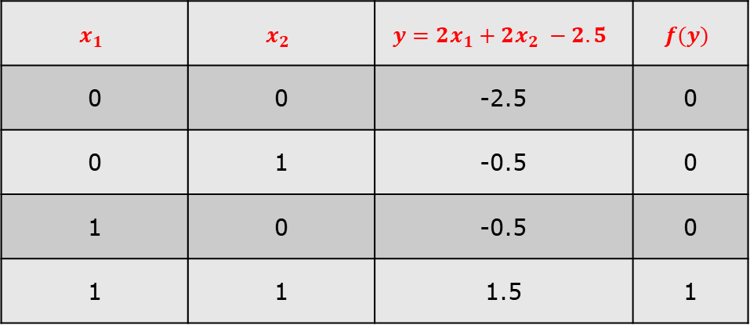
Learning AND gate
$$x_{1}$$ | $$x_{2}$$ | $$y=2x_{1}+2x_{2} −2.5$$ | $$f(y)$$
0 | 0 | -2.5 | 0
0 | 1 | -0.5 | 0
1 | 0 | -0.5 | 0
1 | 1 | 1.5 | 1

Slide 13
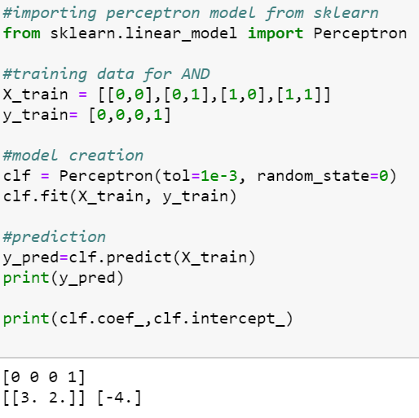
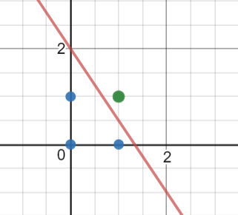
Implementing AND gate
Tools
Python
Sklearn
Try It For
OR, NAND, NOR, XOR

Slide 14
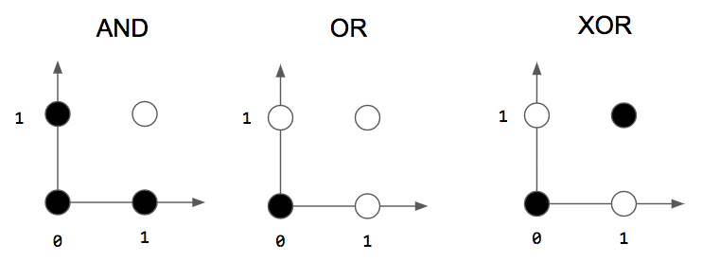
More Gates
?

Slide 15
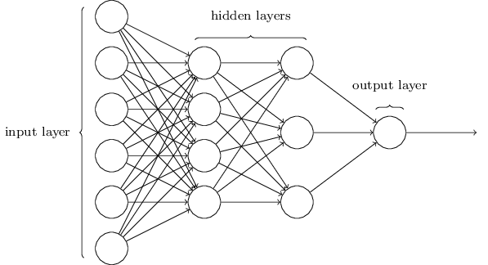
Multi Layer Perceptron(MLP)
Feedforward network: The neurons in each layer feed their output forward to the next layer until we get the final output from the neural network.
There can be any number of hidden layers within a feedforward network.
The number of neurons can be completely arbitrary.
MLP used to describe any general feedforward (no recurrent connections) network

Slide 16
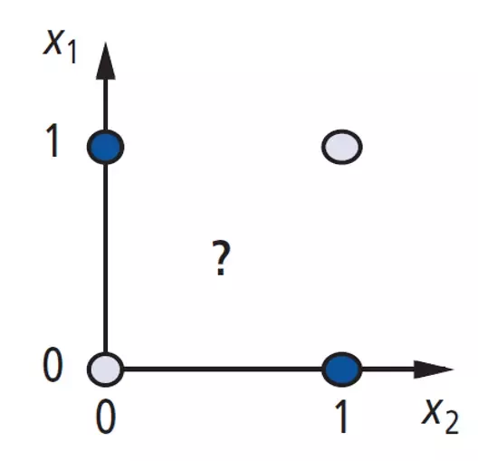
Again to XOR problem
A Perceptron cannot represent Exclusive XOR since it is not linearly separable.
PERCEPTRON -------→ MLP

Slide 17
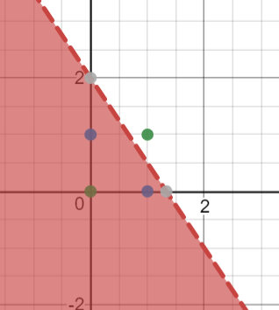
Solution XOR problem
x₁ | x₂ | y
0 | 0 | 0
0 | 1 | 1
1 | 0 | 1
1 | 1 | 0
4
x
-3
O₁
x | y | O₁
0 | 0 | 1
0 | 1 | 1
1 | 0 | 1
1 | 1 | 0
y
-2
Shade indicate 1 (+ve region )

Slide 18
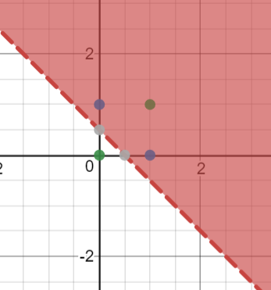
Solution XOR problem
Solution XOR problem
x
1
y
1
O₂
0.5
x₁ | x₂ | y
0 | 0 | 0
0 | 1 | 1
1 | 0 | 1
1 | 1 | 0
x | y | O₂
0 | 0 | 0
0 | 1 | 1
1 | 0 | 1
1 | 1 | 1
Shade indicate 1 (+ve region)

Slide 19
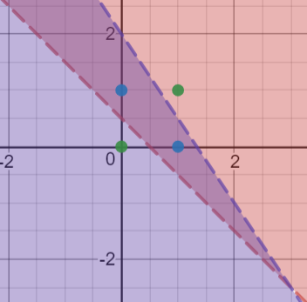
Solution XOR problem
4
-2
x
-3
O₁
1.5
z
1
-2
x₁ | x₂ | y
0 | 0 | 0
0 | 1 | 1
1 | 0 | 1
1 | 1 | 0
y
O₂
1
1
O₁ | O₂ | z
1 | 0 | 0
1 | 1 | 1
0 | 1 | 0
0.5
x | y | O₁
0 | 0 | 1
0 | 1 | 1
1 | 0 | 1
1 | 1 | 0
x | y | O₂
0 | 0 | 0
0 | 1 | 1
1 | 0 | 1
1 | 1 | 1

Slide 20

Three layer networks

Slide 21
Three layer networks
No connections within a layer
No direct connections between input and output layers
Fully connected between layers
Often more than 3 layers
Number of output units need not equal number of input units
Number of hidden units per layer can be more or less than input or output units

Slide 22
Three layer networks
No connections within a layer
No direct connections between input and output layers
Fully connected between layers
Often more than 3 layers
Number of output units need not equal number of input units
Number of hidden units per layer can be more or less than input or output units

Slide 23

Deep Neural Networks

Slide 24

Machine vs Deep Learning

Slide 25
What do each of these layer do ?
1st layer draws linear boundaries
2nd layer combines the boundaries
3rd layer can generate arbitrarily complex boundaries

Slide 26
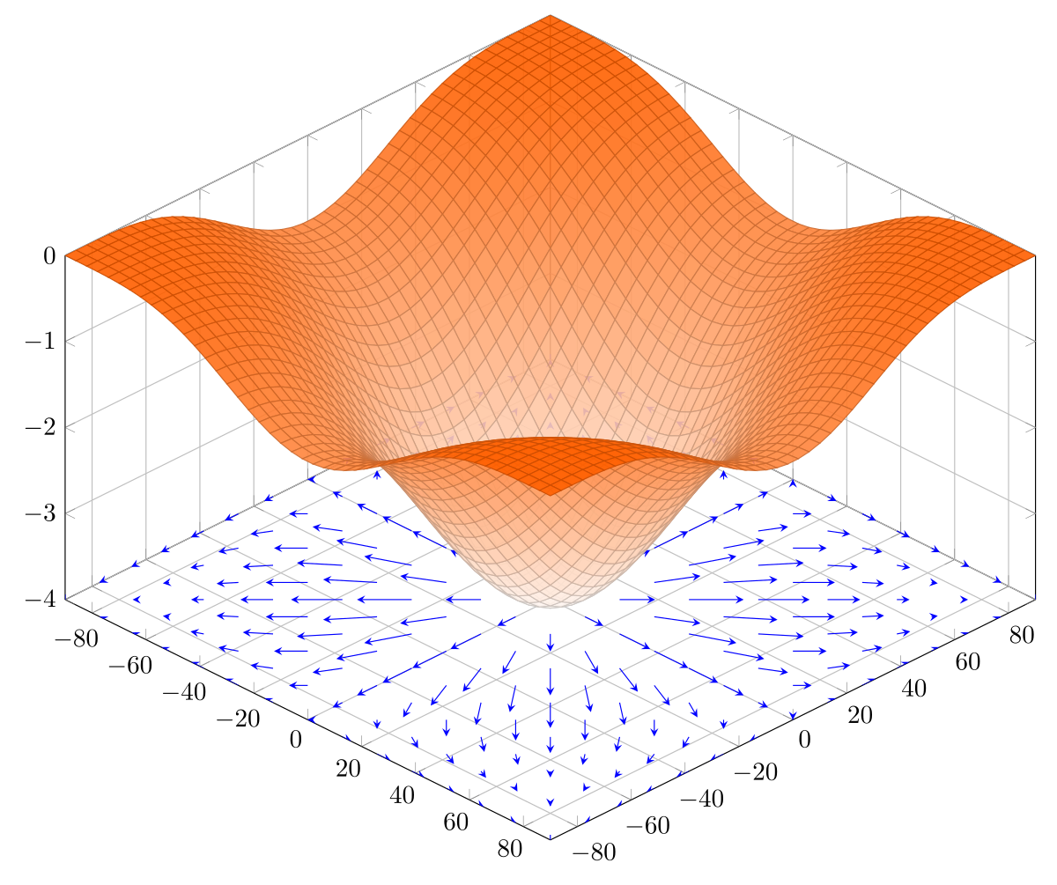
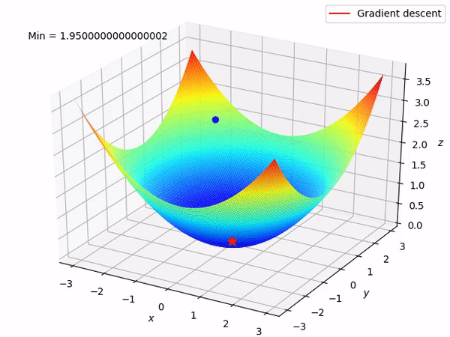
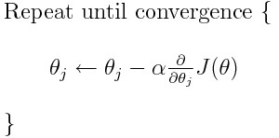
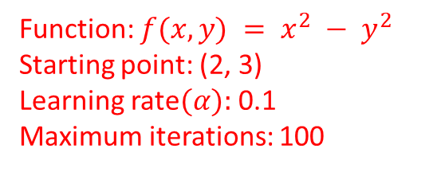
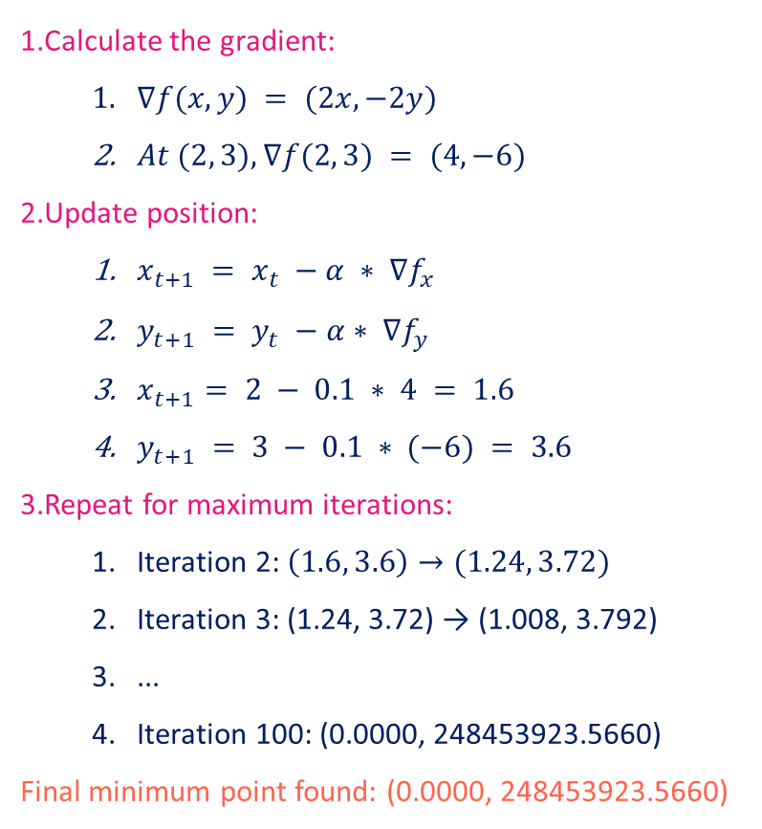
Gradient DESCENT METHOD
Calculate the gradient:
$∇f(x, y) = (2x, −2y)$
$At (2, 3), ∇f(2, 3) = (4, −6)$
Update position:
$x_{t+1} = x_{t} −α ∗ ∇f_{x}$
$y_{t+1} = y_{t} −α∗ ∇f_{y}$
$x_{t+1}= 2 − 0.1 ∗ 4 = 1.6$
$y_{t+1} = 3 − 0.1 ∗ (−6) = 3.6$
Repeat for maximum iterations:
Iteration 2: $\left(1.6, 3.6\right)→(1.24, 3.72)$
Iteration 3: (1.24, 3.72) → (1.008, 3.792)
...
Iteration 100: (0.0000, 248453923.5660)
Final minimum point found: (0.0000, 248453923.5660)
Function: $f(x, y) = x^{2} − y^{2}$
Starting point: (2, 3)
Learning rate$(α):$0.1
Maximum iterations: 100

Slide 27
Backpropagation learning algorithm ‘BP’
BP has two phases:
Forward pass phase: computes ‘functional signal’, feed forward
propagation of input pattern signals through network
Backward pass phase: computes ‘error signal’, propagates the error backwards through network starting at output units (where the error is the difference between actual and desired
output values)

Slide 28
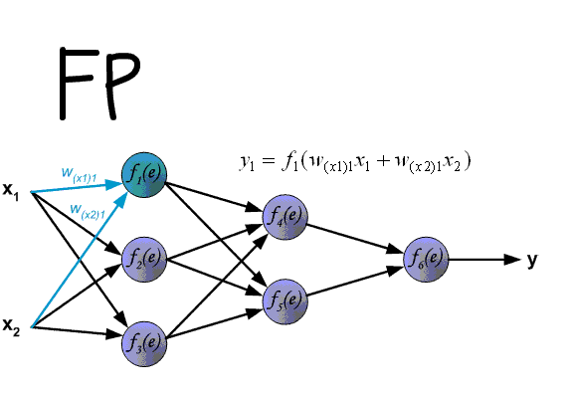
Backpropagation learning algorithm ‘BP’

Slide 29
Backpropagation learning algorithm ‘BP’
● Error gradient along all connection weights were measured by propagating the error from output layer.
● First, a forward pass is performed - output of every neuron in every layer is computed.
● Output error is estimated.
● Then compute how much each neuron in last hidden layer contributed to output error.
● This is repeated backwards until input layer.
● Last step is Gradient Descent on all connection weights using error gradients estimated in previous steps.

Slide 30

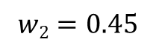
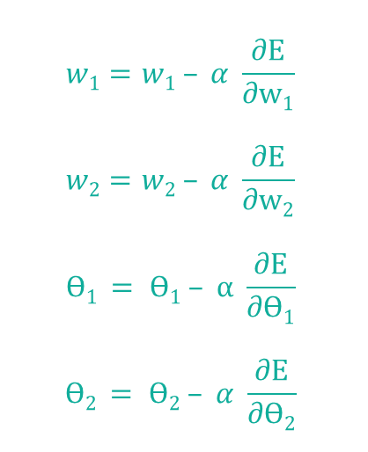
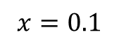
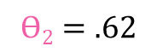
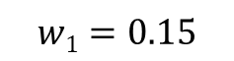
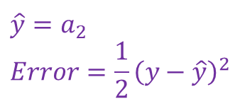
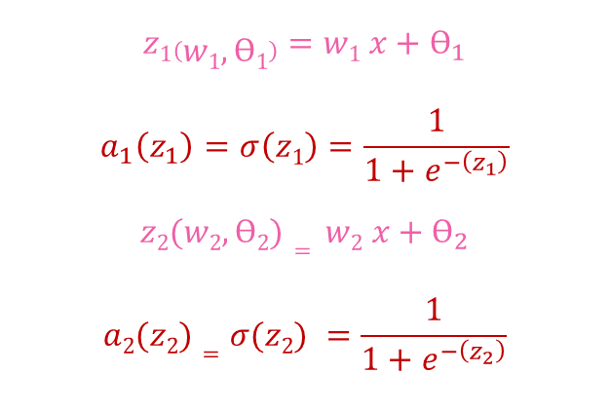
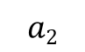
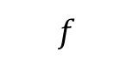

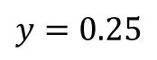
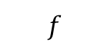
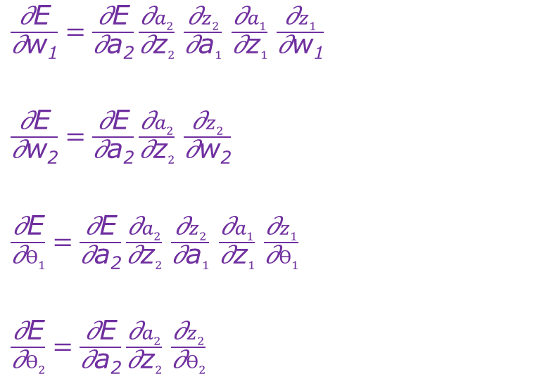
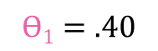


Back PropoAGATION
$$\hat{y}=a_{2} \\ Error=\frac{1}{2}{\left(y−\hat{y}\right)}^{2}$$
$$x=0.1$$
$$a1$$
$$a2$$
$$\hat{y}$$
$$y=0.25$$
$$z1$$
$$f$$
$$z2$$
$$f$$
$$w1=0.15$$
$$w2=0.45$$
$$Ѳ1=.40$$
$$Ѳ2=.62$$
$\frac{\text{∂}\text{E}}{\text{∂}\text{w}\text{1}}=\frac{\text{∂}\text{E}}{\text{∂}\text{a}\text{2}}\frac{\text{∂}a2}{\text{∂}\text{z}2}$ $\frac{\text{∂}z2}{\text{∂}\text{a}1}$ $\frac{\text{∂}a1}{\text{∂}\text{z}1}$ $\frac{\text{∂}z1}{\text{∂}\text{w}\text{1}}$
$\frac{\text{∂}\text{E}}{\text{∂}\text{w}\text{2}}=\frac{\text{∂}\text{E}}{\text{∂}\text{a}\text{2}}\frac{\text{∂}a2}{\text{∂}\text{z}2}$ $\frac{\text{∂}z2}{\text{∂}\text{w}\text{2}}$
$\frac{\text{∂}\text{E}}{\text{∂}Ѳ1}=\frac{\text{∂}\text{E}}{\text{∂}\text{a}\text{2}}\frac{\text{∂}a2}{\text{∂}\text{z}2}$ $\frac{\text{∂}z2}{\text{∂}\text{a}1}$ $\frac{\text{∂}a1}{\text{∂}\text{z}1}$ $\frac{\text{∂}z1}{\text{∂}Ѳ1}$
$\frac{\text{∂}\text{E}}{\text{∂}Ѳ2}=\frac{\text{∂}\text{E}}{\text{∂}\text{a}\text{2}}\frac{\text{∂}a2}{\text{∂}\text{z}2}$ $\frac{\text{∂}z2}{\text{∂}Ѳ2}$
$$w1=w1 – α \frac{∂E}{∂w1}$$
$$w2=w2 – α \frac{∂E}{∂w2}$$
$$Ѳ1 = Ѳ1 – α \frac{∂E}{∂Ѳ1}$$
$$Ѳ2 = Ѳ2 – α \frac{∂E}{∂Ѳ2}$$
$$z1\left(w1,Ѳ1\right)=w1 x+Ѳ_{1}$$
$$a_{1}\left(z_{1}\right)=σ\left(z1\right)=\frac{1}{1+e^{−\left(z_{1}\right)}}$$
$$z2(w2,Ѳ2)= w2 x+Ѳ_{2}$$
$$a2(z2)=σ(z2) =\frac{1}{1+e^{−\left(z_{2}\right)}}$$

Slide 31







$$w1=w1 – α \frac{∂E}{∂w1} =0.15−1∗0.00102=0.148$$
$$w2=w2 – α \frac{∂E}{∂w2}=0.45−1∗0.0570=0.393$$
$$Ѳ1 = Ѳ1 – α\frac{∂E}{∂θ_{1}}= 0.40−1∗0.102=0.389$$
$$Ѳ1 = Ѳ1 – α\frac{∂E}{∂θ_{1}}=0.62−1∗0.094=0.525$$
$$z_{1}\left(w_{1},θ_{1}\right)=w1 x+θ_{1}=0.015∗0.1+0.40=0.415$$
$$a_{1}\left(z_{1}\right)=σ\left(z1\right)=\frac{1}{1+e^{−\left(z_{1}\right)}}=\frac{1}{1+e^{−\left(0.415\right)}}=0.6022$$
$$z_{2}\left(w_{2},θ_{2}\right)=w_{2} x+θ_{2}=0.45∗0.6022+0.63=0.890$$
$$a_{2}\left(z_{2}\right)=σ\left(z_{2}\right)=\frac{1}{1+e^{−\left(z_{2}\right)}}=\frac{1}{1+e^{−\left(0.890\right)}}=0.7088$$
$\frac{\text{∂}\text{E}}{\text{∂}\text{w}\text{1}}=\frac{\text{∂}\text{E}}{\text{∂}\text{a}\text{2}}\frac{\text{∂}a2}{\text{∂}\text{z}2}$ $\frac{\text{∂}z2}{\text{∂}\text{a}1}$ $\frac{\text{∂}a1}{\text{∂}\text{z}1}$ $\frac{\text{∂}z1}{\text{∂}\text{w}\text{1}}$
=($a2$ –y) $a2$ (1- $a2$) w₂ $a1$ (1- $a1$) x
=(0.7088-0.25) 0.7088 (1-0.7088)0.1
=0.00102
$\frac{\text{∂}\text{E}}{\text{∂}\text{w}\text{2}}=\frac{\text{∂}\text{E}}{\text{∂}\text{a}\text{2}}\frac{\text{∂}a2}{\text{∂}\text{z}2}$ $\frac{\text{∂}z2}{\text{∂}\text{w}\text{2}}$
=($a2$ –y) σ$(z2)$(1-σ$(z2)$) $a1$
=($a2$ –y) $a2$ (1- $a2$) $a1$
=(0.7088-.25) 0.7088(1-0.7088)
=0.0570
$\frac{\text{∂}\text{E}}{\text{∂}Ѳ1}=\frac{\text{∂}\text{E}}{\text{∂}\text{a}\text{2}}\frac{\text{∂}a2}{\text{∂}\text{z}2}$ $\frac{\text{∂}z2}{\text{∂}\text{a}1}$ $\frac{\text{∂}a1}{\text{∂}\text{z}1}$ $\frac{\text{∂}z1}{\text{∂}Ѳ1}$
=($a2$ –y) $a2$ (1- $a2$) w₂ $a1$ (1- $a1$) 1
=(0.7088-0.25) 0.7088 (1-0.7088)1
=0.0102
$\frac{\text{∂}\text{E}}{\text{∂}Ѳ2}=\frac{\text{∂}\text{E}}{\text{∂}\text{a}\text{2}}\frac{\text{∂}a2}{\text{∂}\text{z}2}$ $\frac{\text{∂}z2}{\text{∂}Ѳ2}$
=($a2$ –y) σ$(z2)$(1-σ$(z2)$) 1
=($a2$ –0.25) $a2$ (1- $a2$)
=0.0946

Slide 32
More OptimiZERS
Optimizers
Algorithms or methods used to minimize an error function (loss function)or to maximize the efficiency of production.
Mathematical functions which are dependent on model’s learnable parameters i.e Weights & Biases.
Gradient Descent
Stochastic Gradient Descent
Stochastic Gradient Descent with Momentum
Mini-Batch Gradient Descent
AdaGrad(Adaptive Gradient Descent)
RMS-Prop (Root Mean Square Propagation)
AdaDelta
Adam(Adaptive Moment Estimation)

Slide 33



Stochastic Gradient Descent
Stochastic means randomness on which the algorithm is based upon
A variant of gradient descent that involves updating the parameters based on a small, randomly-selected subset of the data rather than the full dataset.
$$θ_{t+1}= θ_{t} −α∇_{θ}L_{i}(θt)$$
$θ_{t}$represents the parameter vector at iteration $t$.
$∇_{θ}L_{i}(θ_{t})$is the gradient of the loss function for a randomly chosen training example at the current parameter vector $θ_{t}$ .
𝛼 is the learning rate, determining the step size of the parameter updates.

Slide 34



MINI-BATCH Gradient Descent
Best among all the variations of gradient descent algorithms
$$θ_{t+1}= θ_{t} −α{\frac{1}{\left|B\right|}∇}_{θ}\sum_{iεB}{L_{i}(θt)}$$
Mini-batch gradient descent is similar to SGD, but instead of using a single sample to compute the gradient, it uses a small, fixed-size "mini-batch" of samples
$θ_{t}$represents the parameter vector at iteration t.
${\frac{1}{\left|B\right|}∇}_{θ}\sum_{iεB}{L_{i}(θt)}$ is the average gradient of the loss function for a randomly chosen training example at the current parameter vector $θ_{t}$.
𝛼 is the learning rate, determining the step size of the parameter updates.

Slide 35

SGD with MOMENTUM
Momentum
Momentum was invented for reducing high variance in SGD and softens the convergence.
It accelerates the convergence towards the relevant direction and reduces the fluctuation to the irrelevant direction.
$θ_{t}$represents the parameter vector at iteration t.
$$θ_{t+1}=θ_{t} −v_{t+1}$$
$v_{t+1}= ηv_{t}+α∇_{θ}L(θ_{t}$)
$∇_{θ}L(θ_{t}$) is the gradient of the loss function for a randomly chosen training example at the current parameter vector $θ_{t}$.
𝛼 - is the learning rate determining the step size of parameter updates.
𝜐 - t is the momentum term at iteration t.
$η$ - is the momentum coefficient(typically between 0 and 1),determining how much of the previous momentum to retain.

Slide 36


SGD VariAnts

Slide 37



AdaGrad(Adaptive Gradient Descent)
Adagrad is an optimization algorithm that uses an adaptive learning rate per parameter.
The learning rate is updated based on the historical gradient information so that parameters that receive many updates have a lower learning rate, and parameters that receive fewer updates have a larger learning rate.

Slide 38


Ada DELTA
AdaDelta is an optimization algorithm similar to RMSProp but does not require a hyperparameter learning rate.
It uses an exponentially decaying average of the gradients and the squares of the gradients to determine the updated scale.
$θ_{t}$​: Parameter vector at iteration t
$θ_{t−1}$​: Parameter vector at iteration t−1
η: Learning rate
$G_{t}$​: Diagonal matrix of accumulated squared gradients up to iteration t
ϵ: Small positive value to prevent division by zero
$g_{t}$​: Gradient of the loss function with respect to $θ_{t}$Visualization:

Slide 39



RMSPrOP(Root MEAN SQUARE Probability)
RMSProp is an optimization algorithm similar to Adagrad, but it uses an exponentially decaying average of the squares of the gradients rather than the sum.
Helps to reduce the monotonic learning rate decay of Adagrad and improve convergence.
$$ε is a small positive constant for numerical stability.η is the learning rate.γ is the decay rate for the RMSprop accumulator, typically set to 0.9 or 0.99.v_{t} is the exponentially decaying average of squared gradients, also known as the RMSprop accumulator.g_{t} is the gradient of the loss function L\left(θ_{t}\right) with respect to the parameters θ_{t} at time step t.$$

Slide 40


Adam(Adaptive moment estimation)
Adam is an optimization algorithm that combines the ideas of SGD with momentum and RMSProp.
It uses an exponentially decaying average of the gradients and the squares of the gradients to determine the updated scale, similar to RMSProp

Slide 41


Activation: Sigmoid
Nice interpretation as the firing rate of a neuron
0 = not firing at all
1 = fully firing
Sigmoid neurons saturate and kill gradients, thus NN will barely learn
when the neuron’s activation are 0 or 1 (saturate)
gradient at these regions almost zero
almost no signal will flow to its weights
if initial weights are too large then most neurons would saturate
$$R^{n}→\left[0,1\right]$$
Takes a real-valued number and “squashes” it into range between 0 and 1.

Slide 42



Activation: Tanh
Like sigmoid, tanh neurons saturate
Unlike sigmoid, output is zero-centered
Tanh is a scaled sigmoid$: tanh⁡(x)=2σ(2x)−1$
$$R^{n}→\left[−1,1\right]$$
Takes a real-valued number and “squashes” it into range between -1 and 1.
Notes:
not zero-centered: later layers of processing would be receiving data that is not zero-centered.
if data coming into a neuron is always positive then the gradient on the weights will be either all be positive, or all negative (depending on the gradient of the whole expression). Could introduce undesirable zig-zagging dynamics in the gradient weight updates. However, once these gradients are added up across a data batch the final weight update can have variable signs, somewhat mitigating this issue.

Slide 43



Activation: ReLU
Most Deep Networks use ReLU nowadays
Trains much faster
accelerates the convergence of SGD
due to linear, non-saturating form
Less expensive operations
compared to sigmoid/tanh (exponentials etc.)
implemented by simply thresholding a matrix at zero
More expressive
Prevents the gradient vanishing problem
$$f\left(x\right)= max⁡(0,x)$$
$$R^{n}→R_{+}^{n}$$
Takes a real-valued number and thresholds it at zero
Notes:
ReLU units can “die”
large gradient flowing through a ReLU could cause weights to update in such a way that the neuron will never activate on any datapoint again
gradient flowing through the unit will forever be zero from that point on
With a proper setting of the learning rate this is less frequently an issue

Slide 44



Loss Functions
True Label | Prediction | Binary Cross-Entropy
1 | 0.9 | 0.10536052
0 | 0.1 | 0.10536052
1 | 0.8 | 0.22314355
0 | 0.2 | 0.22314355
1 | 0.7 | 0.35667494
0 | 0.3 | 0.35667494
1 | 0.6 | 0.51082562
0 | 0.4 | 0.51082562
1 | 0.5 | 0.69314718
0 | 0.5 | 0.69314718
True label = [1, 0, 0], predicted probabilities = [0.8, 0.1, 0.1]
CCE = -(1 * log(0.8) + 0 * log(0.1) + 0 * log(0.1)) ≈ 0.2231
True label = [0, 1, 0], predicted probabilities = [0.4, 0.5, 0.1]
CCE = -(0 * log(0.4) + 1 * log(0.5) + 0 * log(0.1)) ≈ 0.6931
True label = [0, 0, 1], predicted probabilities = [0.2, 0.3, 0.5]
CCE = -(0 * log(0.2) + 0 * log(0.3) + 1 * log(0.5)) ≈ 0.6931

Slide 45
Take AWays
Mathematical Foundations for Optimization
Neural Networks
Perceptron
Multilayer Perceptron
Deep Neural Networks
Gradient Descent
Back Propagation
Optimizers
Activation Functions
Loss Functions

Slide 46





Dr. Shailesh Sivan
+91 8907230664
shaileshsivan@cusat.ac.in
https://shaileshsivan.info

